Slide 1


Needs-driven continuous professional development – it’s in your hands.
Christopher Graham
Academic Director, Garnet Education

Slide 2
“This house believes that teacher training is a waste of time”
IATEFL Conference debate, 2016
What do you think?

Slide 3
About me
Director – Academic and Training, Garnet Education
In ELT for over 35 years.
Teacher, teacher educator, conference speaker and writer.
British Council Algeria, Iraq and Sierra Leone.
Author of Training the Trainer – A Resource Book for ELT Professionals, Garnet 2020.
Contributing editor of 21st Century Skills in the ELT Classroom –
A Guide for Teachers, Garnet 2020.
Regular contributor to ELT journals and blogs.
Co-founder of ELT Footprint.
christophergraham@garneteducation.com

Slide 4
Who are the stakeholders?
Schools
Teachers
Management
Administrators
Students
Parents
Exam providers
Publishers
School associations or groups
PD providers
Conference organisers

Slide 5
CPD
What makes for good CPD?
Self-selected, needs-driven professional development.

Slide 6
Continuous Professional Development – what are the issues?
Development – a continuous dynamic of growth or change.
Teacher development – understanding of teaching and growing self-awareness.
Interpretation of self and experiences.

Slide 7
There are no new ideas in life
Confucius (c500)
"By three methods we may learn wisdom: First, by reflection, which is noblest; second, by imitation, which is easiest; and third by experience, which is the bitterest."

Slide 8
Reflective practice – a definition
Reflective practice
A way of assessing our own thoughts and actions to facilitate personal learning and development.

Slide 9
Reflective practice – a definition
Using:
how we see ourselves and situations now,
and
how we see ourselves and situations in the past to improve our present and future.

Slide 10
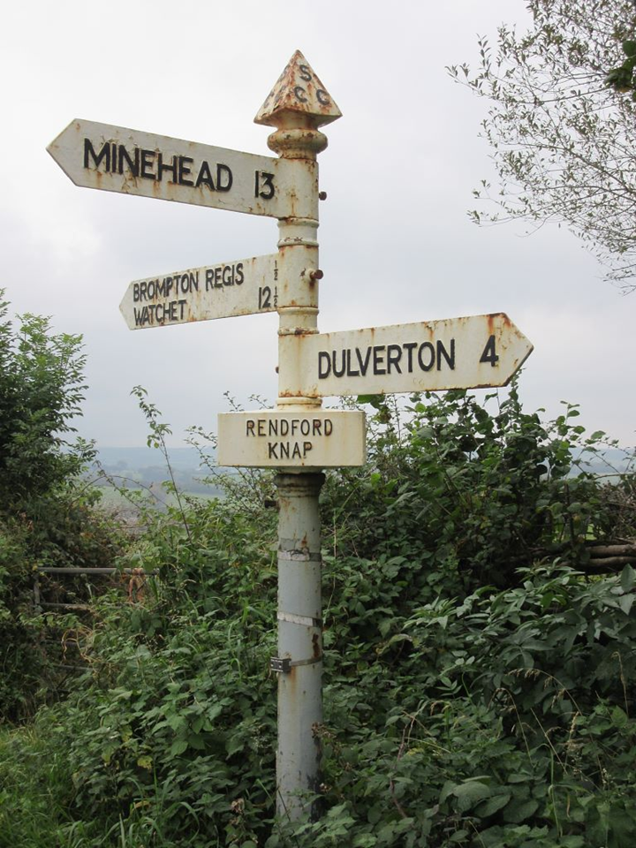
R A story

Slide 11
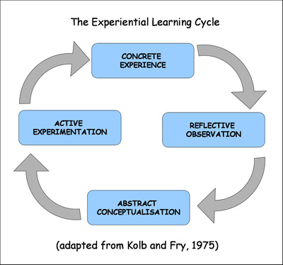
David Kolb

Slide 12
KASA – Donald Freeman
Knowledge
Awareness
Skills
Attitude
Record patterns rather than one-offs.

Slide 13
KASA
Knowledge
various adult methodologies, language itself +
phonology, testing -
Awareness
local context, cultural setting +
local exam structure -
Skills
presentation skills, collating data +
interpersonal, team playing -
Attitude
helpful, friendly +
empathy, generous with time -

Slide 14
KASA let’s try it out
Knowledge
Awareness
Skills
Attitude

Slide 15
Issues in reflective practice
Objectivity
Objectivity – it’s about us, so being subjective is normal. Especially when stressed or upset.
Refection leads to action, so needs to be based on accurate data to avoid unhelpful results.

Slide 16
Issues in reflective practice
Timing
Immediate reflection can solve a problem reactively but lacks the broader context and the facility to develop strategic improvement and change.
The quality of changes based upon reflection may be connected to how quickly reflection takes place.

Slide 17
Issues in reflective practice
A military approach
Hot reviews can be emotional and subjective, and develop quick fixes with no strategy for improvement.
Cold reviews are more objective and contextualised. Better reflections, higher self-awareness – usually better outcomes.
Analysing using both approaches gives you a fuller picture.

Slide 18
Reflective practice in your classes
Some ideas – most can be ‘hot’ and ‘cold’.
Reflective journal, notes or diary.
Reflective forums or blogs.
Reflective conversations.
Peer observation – two way.

Slide 19
Reflective practice in your classes
Images
Classroom-based research projects.
Can be very small scale – it’s not a PhD.
Can just be shared within your institution or local association. http://resig.weebly.com/

Slide 20
Reflective practice in your classes
Audio recordings – useful for TTT. What do you say, how much and when? How much do students speak? How do you interact with them? How do you correct them?
Video recordings – your position in class, how do you move around class? What are your gestures like?
Student feedback.

Slide 21
What next?
What to do next
  Collate and manage data
  Examine objective and subjective ideas. Subjectivity matters too
  Think
  Write
  Talk
  Read
  Ask?
Conclusion

Slide 22
What next?
Remember, repeated situations – not one-offs are indicative of an issue.
The context matters a lot and your behaviour and reaction may be conditioned by external issues.

Slide 23
What next?
Reflection
Understanding
Action
Action is likely to be the creation of some sort of CPD path, within or outside the employer.

Slide 24
Some CPD thoughts
CPD can be sub-divided into ‘chunky’, top down training like the DELTA
and
informal, specialist content that enriches teaching.
CPD often comes to you, rather than your coming to it.
The effectiveness of CPD is hard to measure.

Slide 25
How do we avoid ‘one-size fits all’ CPD?

Slide 26
21st Century CPD
Official CPD is probably a given.
Make your own learning path and follow it online.
Reflection-driven needs analysis.
Alone or in peer groups or associations.

Slide 27
British Council Teaching for Success CPD Framework

Slide 28
British Council https://www.teachingenglish.org.uk/
IATEFL https://www.iatefl.org/events
TeacherTrainingVideos (Russell Stannard) http://www.teachertrainingvideos.com/
EFL Talks http://www.efltalks.com/index.html

Slide 29
TEFL Commute
http://www.teflcommute.com/what-is-tefl-commute/
International Teacher Development Instutute
http://itdi.pro/itdihome/
ELT Jam
https://eltjam.com/training-academy/

Slide 30

Last but not least
https://www.garneteducation.com/podcast/

Slide 31
References
Confucius. (c500). The Analects: ch2.
Kolb, D. A., & Fry, R. E. (1974). Toward an applied theory of experiential learning. MIT Alfred P. Sloan School of Management.
Freeman, D. (1989). Teacher Training, Development, Decision Making: A Model for Teaching and Related Strategies for Language Teacher Education. TESOL Quarterly, 23(1), 27-45.
British Council https://www.teachingenglish.org.uk/sites/teacheng/files/CPD_framework_for_teachers_WEB.PDF

Slide 32
Reflection

Slide 33
Thanks for your time
christophergraham@garneteducation.com

